Slide 1
CAR SHOW ROOM

Slide 2
ABSTRACT
The main aim of this car store project is to create a web-based application using JAVA and MYSQL for an online car show room system that includes the customers to search for cars and order online and manage their online bookings
Online Car Store System is a website that allows a customer to search for various cars available at the store, segregate according to the price and model, Unique data of cars available, Time it takes for a car to get delivered, book the car online and enter the date they would visit the store and also allows customers to book for a test drive.
If they are accepting the product, manually can able to book and register via online. Also we can show the new model car are available or not in the car show room.

Slide 3
HARDWARE SPECFICATION
Processor : P 4 700 GHz.
RAM : 4 GB RAM
Hard Disk Drive : 180 GB

Slide 4
SOFTWARE SPECIFICATION
Operating System : Windows 7/8/10
Front End : JAVA
Back End : MYSQL

Slide 5
EXISTING SYSTEM
In the existing scenario, if someone has to buy a car or even interested in buying any car, then the person has to go to the showroom. Not only once, but every time, whenever he/she is looking for some fact, the only option left is to go to the showroom. This is very time consuming and very hectic as well. Sometimes, the buyer even lost interest because of this practice.
DRAWBACKS:
Its waste of time to visit the show room and collect the information about the car.
No way to find new model car.
Hard to manage the customer details

Slide 6
PROPOSED SYSTEM
The proposed Car showroom management system is very effective. If someone is interested in buying any car, then he/she can check all the information related to the car in the given portal. He/she can even book the test drive within the system. The proposed system also helps the buyer to check which cars and companies are good for them, by showing them the past reviews about the car/companies. The proposed system is so helpful and effective.
FEATURES:
Easy to manage the customer details
Save time & cost

Slide 7
Modules
Admin/User Login
Add Car Details
Car Booking
Booking Details
Contact Customers

Slide 8
Modules
Admin/User Login
Admin or user either can using this application, user need to register before login. Which login credential they gave to create their account should use same credential to access this application. Otherwise, we won’t allow to enter into the login.
Add Cars Details
After admin login the admin register the new model cars details and photos as well. Once the photos have been uploaded these will be stored into the server. Which photos can be mapped into the view car models screen for the user.

Slide 9
Car Booking
The user can able to view the new model’s car’s in his home pages. If they are like to buy this car, they can able to register if the stocks are available. This will be notified to the car show room workers or managers.
View Booking details
Once the car details have been registered which details are viewing into the booking details screen. They can able to view the all the customer details and their favorite car details.
This will be giving cumulative report for the show room booking details

Slide 10

Data Flow Diagram
Level 0:

Slide 11
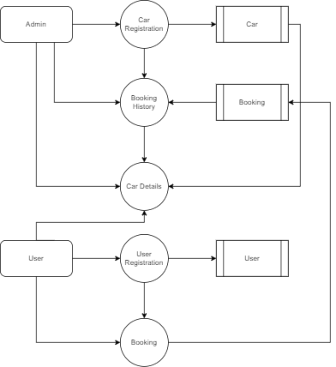
Level 1:

Slide 12
Table name: admin
FIELD | DATA TYPE | SIZE | CONSTRAINT
Username | Varchar | 10 | Not null
Password | Varchar | 5 | Not null

Slide 13
TABLE NAME: Customer
FIELD | DATA TYPE | SIZE | CONSTRAINT
customer id | Int | 5 | Primary key
firstname | Varchar | 30 | Not null
last name | Varchar | 30 | Not null
email | Varchar | 30 | Not null
Password | Varchar | 30 | Not null
Mobile no | Int | 10 | Not null

Slide 14
TABLE NAME: Car
FIELD | DATA TYPE | SIZE | CONSTRAINT
car id | Int | 5 | Primary key
Name | Varchar | 30 | Not null
Model | Varchar | 30 | Not null
Engine | Varchar | 30 | Not null
Width | Varchar | 30 | Not null
Height | Varchar | 30 | Not null
Price | Int | 10 | Not null
Year | Int | 10 | Not null

Slide 15
TABLE NAME: Booking
FIELD | DATA TYPE | SIZE | CONSTRAINT
Booking id | Int | 10 | Primary Key
Customer id | Int | 10 | Foreign Key
Car Id | Int | 10 | Foreign Key
Expected | Varchar | 30 | Not null
Suggestion | Varchar | 30 | Not null

Slide 16
Table name: payment
FIELD | DATA TYPE | SIZE | CONSTRAINT
Payment id | Int | 5 | Primary key
Policy id | Int | 5 | Foreign key
Customer id | Int | 5 | Foreign key
Agent id | Int | 5 | Foreign key
Last payment | Int | 7 | Not null
Remaining amount | Int | 7 | Not null

Slide 17
Thank You

